Slide 1
The Göttingen Campus
A STRONG ALLIANCE

Slide 2
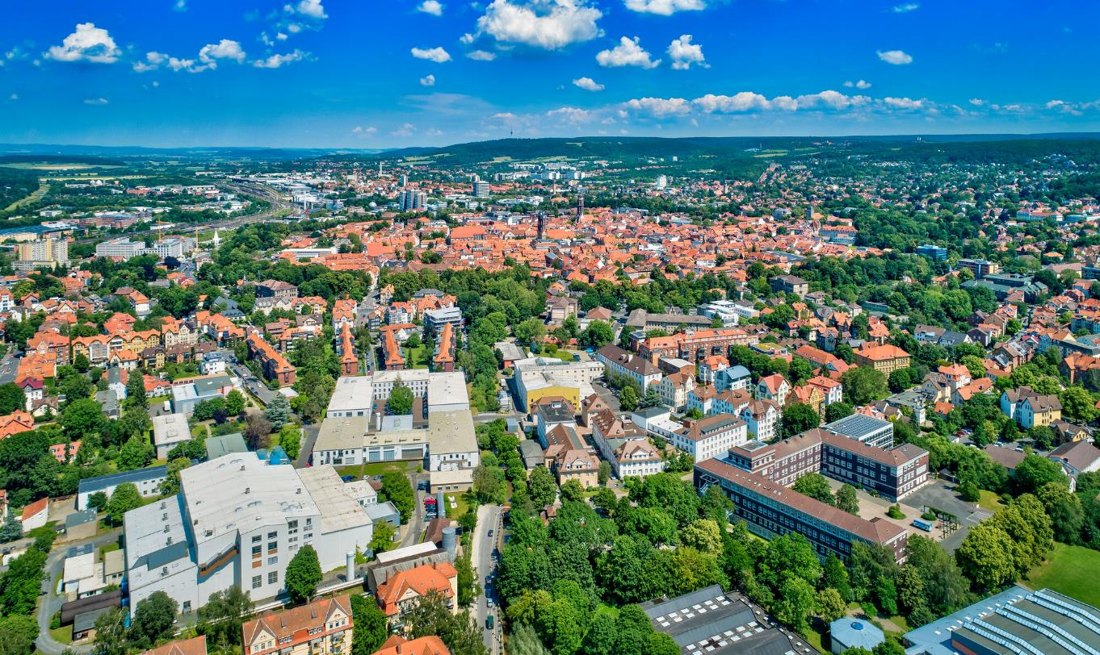
GÖTTINGEN

Slide 3
MEMBERS
2 km

Slide 4
OBJECTIVE
Promoting research, teaching, and the training of early career researchers.
The aim of the Göttingen Campus is to make a valuable contribution to address the challenges of our time, drawing on:
An exceptionally wide range of subjects
A long-standing tradition of delivering high quality research outputs
Visible and accessible knowledge “for the good of all”
Highly collaborative research in joint projects involving all Campus members
Diversity of research whether from joint or individual projects
A strong emphasis on research-oriented teaching

Slide 5
ASSOCIATE PARTNERS

Slide 6
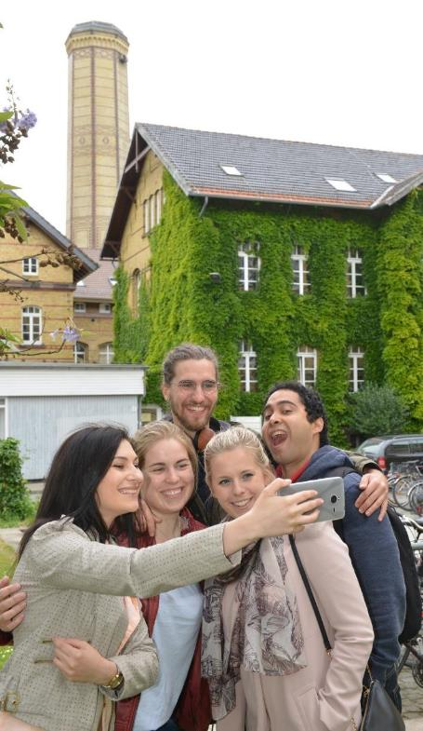
GRADUATE SCHOOLS
Graduate School of Forest and Agricultural Sciences (GFA)
Göttingen Graduate School of Social Sciences (GGG)
Graduate School of Humanities Göttingen (GSGG)
Georg August University School of Science (GAUSS) including: Göttingen Graduate Center for Neurosciences, Biophysics, and Molecular Biosciences (GGNB)
INTERNATIONAL MAX PLANCK RESEARCH SCHOOLS
IMPRS for Molecular Biology
IMPRS for Neurosciences
IMPRS Physics of Biological and Complex Systems
IMPRS for Solar System Science
IMPRS for Genome Science
MAX PLANCK SCHOOL MATTER TO LIFE

Slide 7
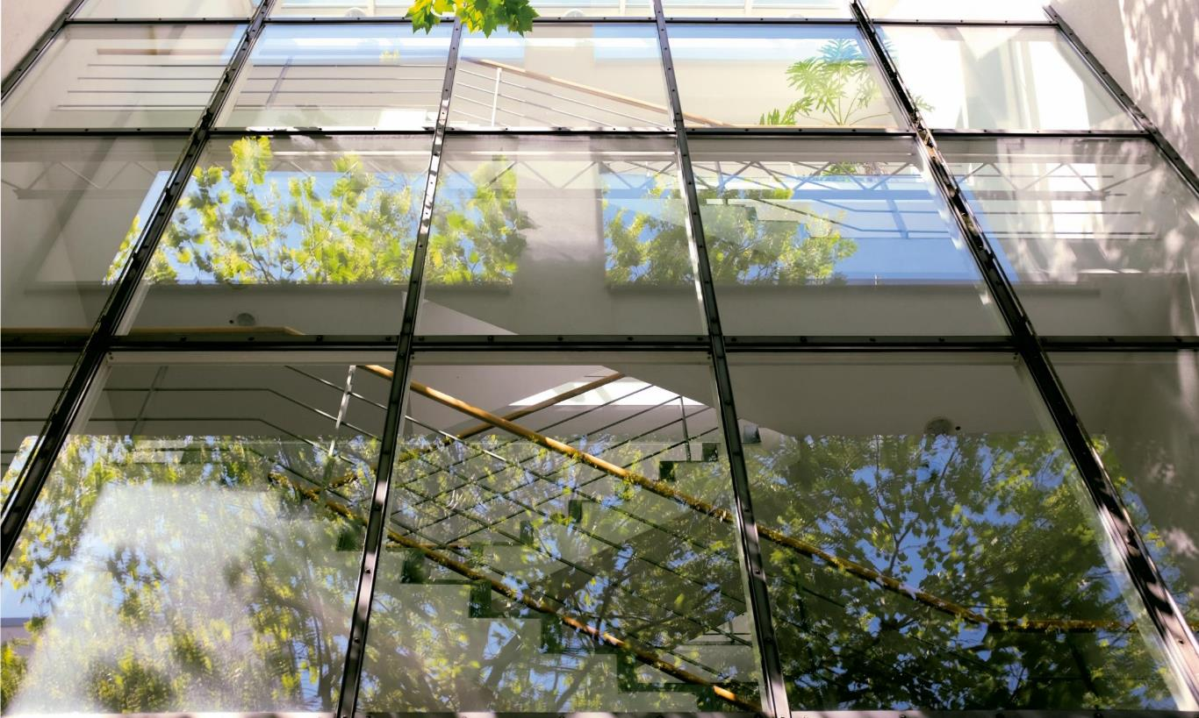
JOINT RESEARCH & INFORMATION INFRASTRUCTURE
DATA CENTRE
GWDG Göttingen Computing and IT Competence Centre
eRa Göttingen eResearch Alliance
LIBRARY
SUB Göttingen State and University Library
GÖTTINGEN CAMPUS INSTITUTES CIDAS Campus Institute Data Science
CIDBN Göttingen Campus Institute for Dynamics of Biological Networks
CAMPUS LABORATORIES
AIMS Advanced Imaging, Microscopy and Spectroscopy

Slide 8
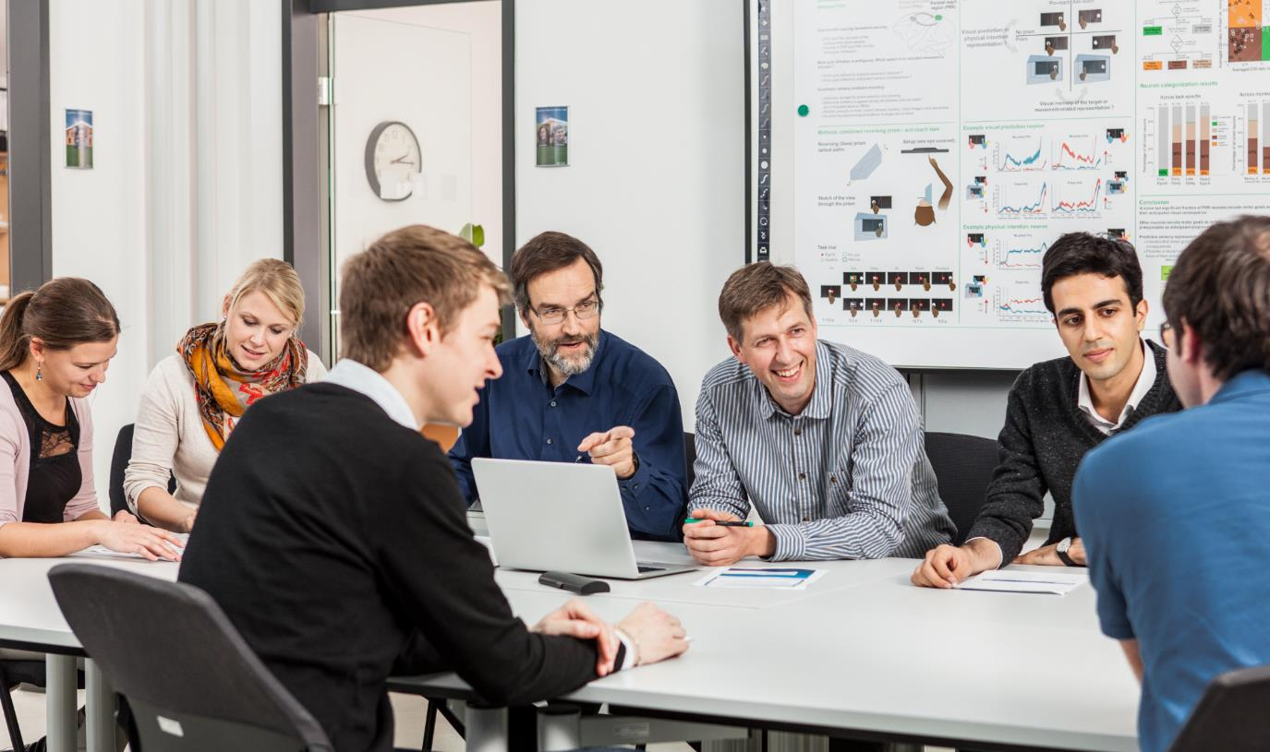
JOINT RESEARCH AT THE GÖTTINGEN CAMPUS
Cluster of Excellence Multiscale Bioimaging: from Molecular Machines to Networks of Excitable Cells
9 Collaborative Research Centres coordinated by Göttingen scientists
CRC 1528: Cognition of Interaction
CRC 1456: Mathematics of Experiment: The challenge of indirect measurements in the natural sciences
CRC 1286 Quantitative Synaptology
CRC 1190 Compartmental Gates and Contact Sites in Cells
CRC 1073 Atomic scale control of energy conversion
CRC 1002 Modulatory Units in Heart Failure
CRC 990 Ecological and socioeconomic functions of tropical lowland rainforest transformation systems (Sumatra, Indonesia)
CRC 889 Cellular Mechanisms of Sensory Processing
CRC 860 Integrative Structural Biology of Dynamic

Slide 9
GOVERNANCE
GC Council (GCC)
Represents the interests of the members and develops strategic directions
Identifies new key research areas and initiates central projects
Promotes greater integration among member institutions
GC Executive Board
Coordinates ongoing activities and makes proposals for strategic directions
+
Extended GCC
Promotes the exchange between member institutions and associated partner organisations (meets yearly)

Slide 10
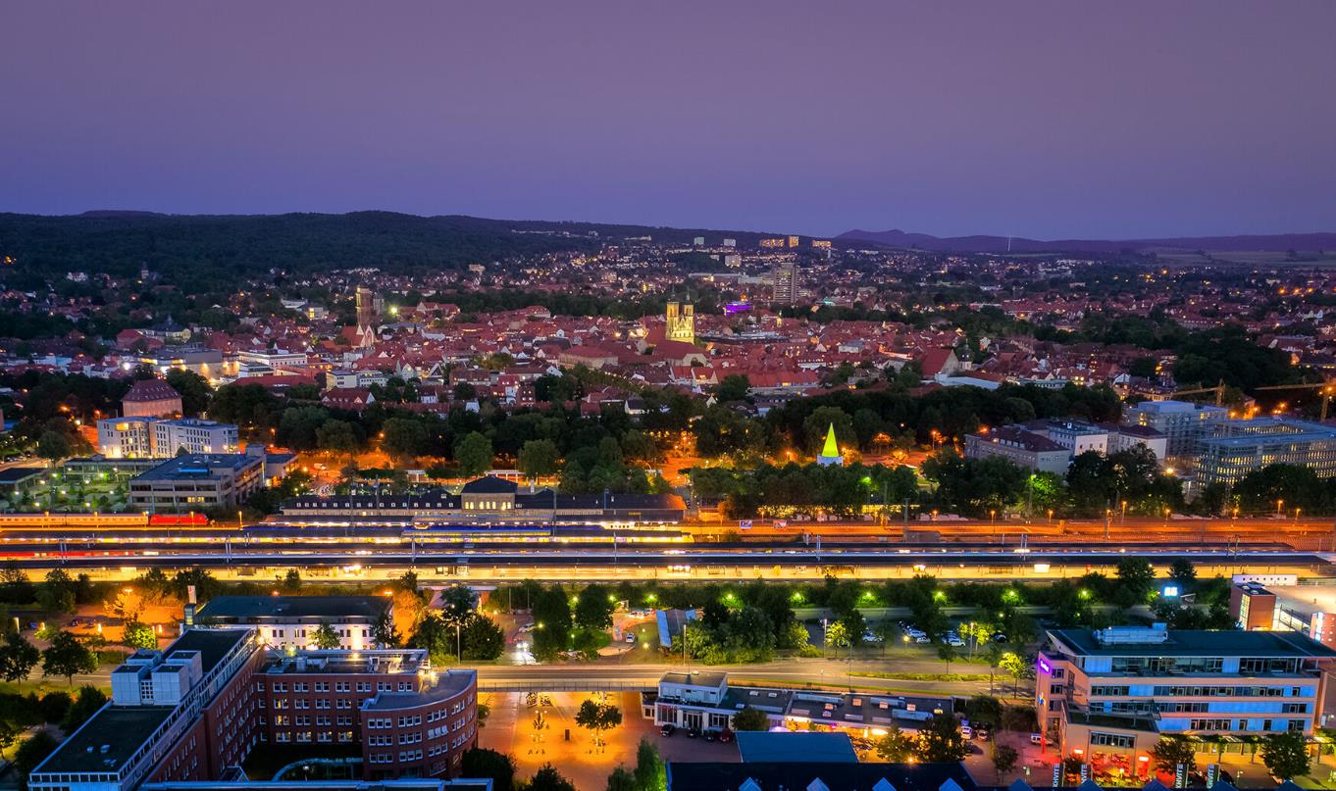
www.goettingen-campus.de
X: @thegoecampus

